Slide 1


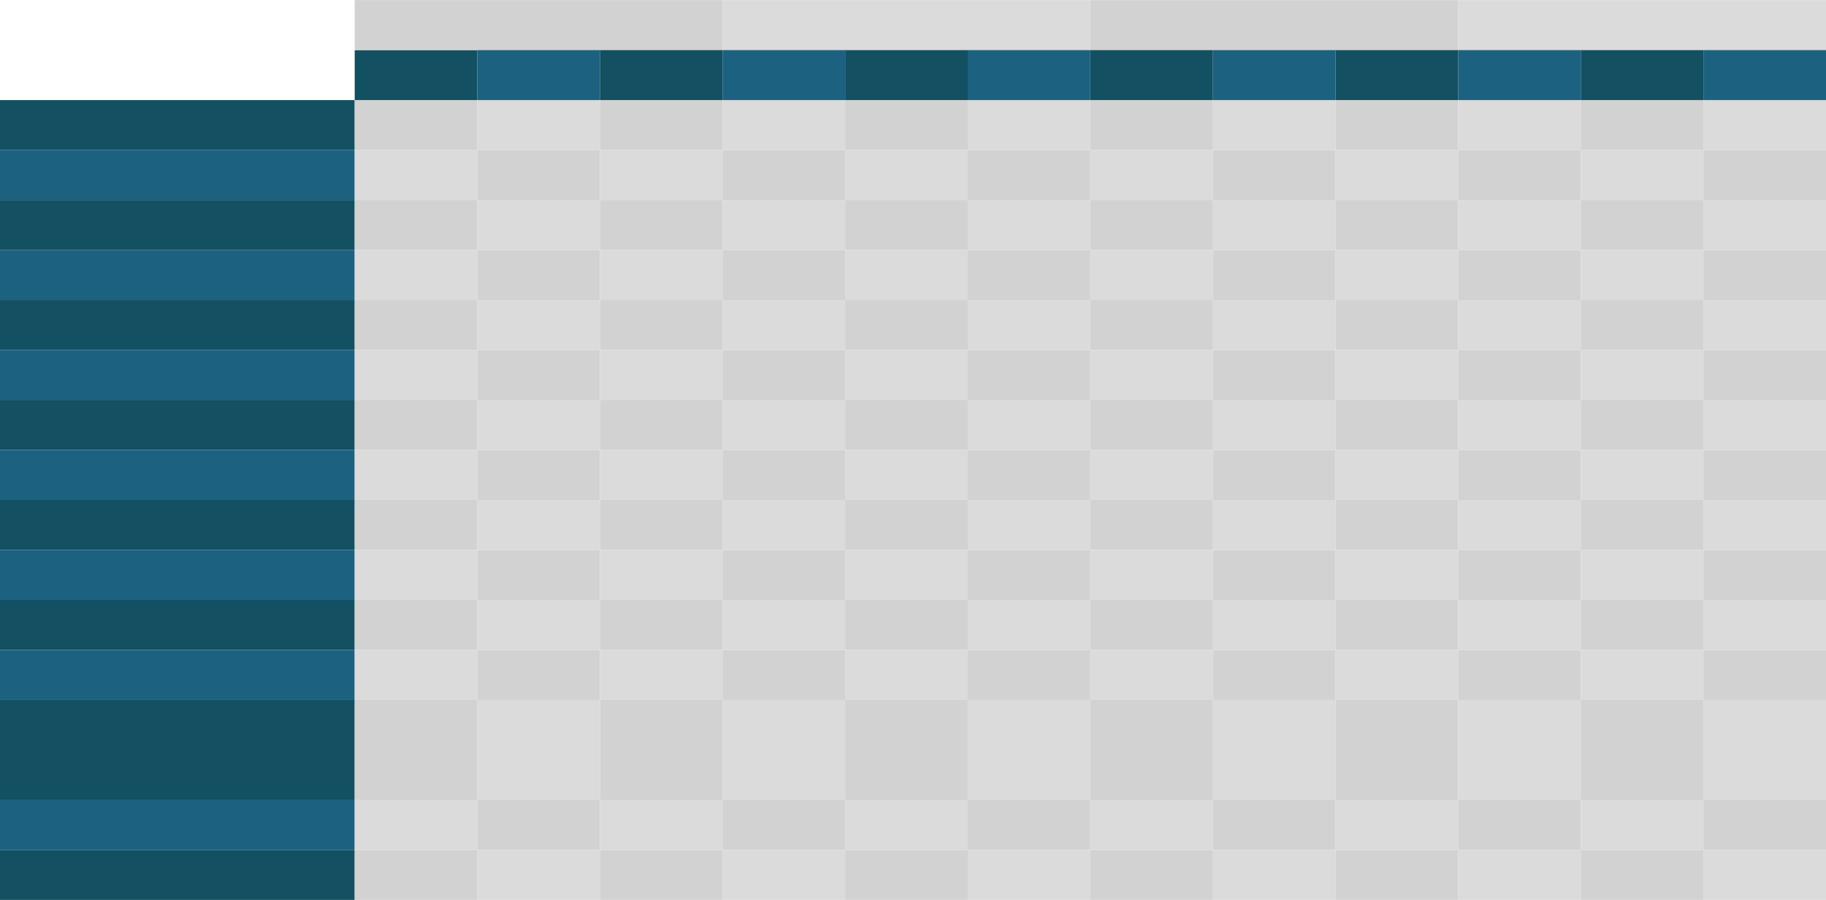
////
Smart Hub and My Crop– Road Map 2023 - 2024
Q3 2023
Q4 2023
Q1 2024
Q2 2024
Q3 2024
Q4 2024
Jul
Aug
Sep
Oct
Nov
Dec
Jan
Feb
Mar
Apr
May
Jun
Jul
Aug
Sep
Oct
Nov
Dec
Widget My Crop
Prototype Adjust
Development
Tests
Corn Recommendation Models and Endpoints
Foundation and Archtecture
Models: Ranking and Head-to-Head
Endpoint: AgroBayer
Density,
Catalog,
CropMonitoring.
Diseases map
Product Information
Discovery of MPI and PIM rollout for Latam
Endpoint
AI for all recommendations and predictive models
Carbon recommendation Models and Endpoints
Early engagement
Discovery
Carbon calculator
endpoint procarbono website
Soybean recommendation Models and Endpoints
Discovery
Console adjustment
Models: Ranking
Head to Head
Density,
Catalog
CropMonitoring
Endpoint::AgroBayer and Field View
CP recommendation Models and Endpoints
Discovery
Console adjustment
Models: Ranking, Head to Head
Endpoint::AgroBayer, Cultivio Field View
Agronomic Techinical Content
Discovery
Implementation of process for content creation
Connection between SmartHub backend and Content Creation and Management Tool.
Not started
On track
In progress
Delayed
risk
Concluded

